Slide 1
Fundamental Big Data Analysis & Science
Machine learning

Slide 2
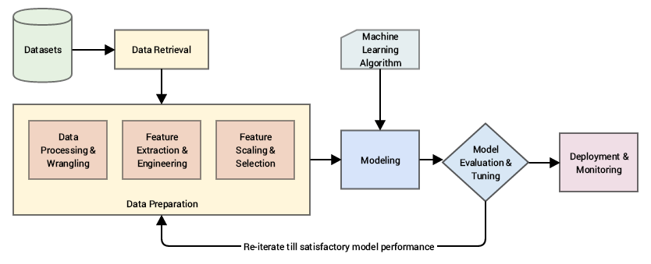
What is Machine Learning?

